Slide 1

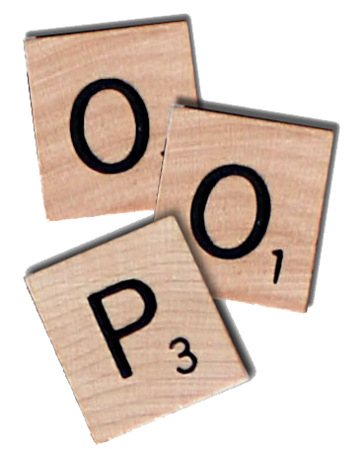

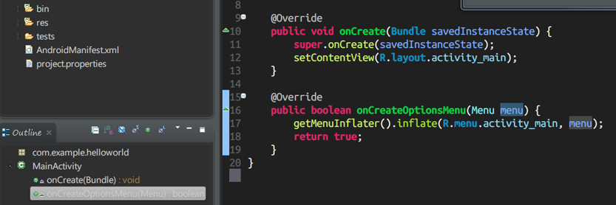
Object-Oriented Programming
Course Introduction
SoftUni Team
Technical Trainers
Software University
http://softuni.bg

Slide 2

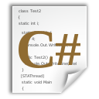



Table of Contents
Course Objectives
Course Program
Trainers Team
Examination
Learning Resources

Slide 3







SoftUni Diamond Partners

Slide 4

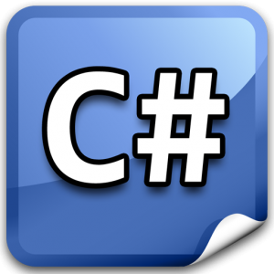
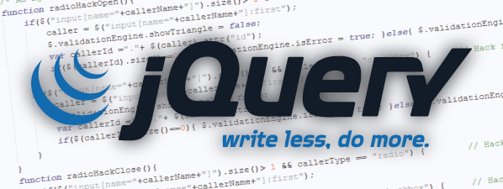


Level #2 at the Software University
OOP (C#, Java, PHP)
11 times + exam + TW
6 weeks * 2 times
JS OOP
5 times + exam + TW
3 weeks * 2 times
JS Apps
6 times + exam + TW
4 weeks * 2 times
Angular JS
4 times + project
3 weeks * 2 times
High-Quality Code
12 times + exam + TW
16 weeks * 1 time

Slide 5

OOP Course
Object-Oriented Programming
Course Objectives & Program

Slide 6
Course Objectives
The "OOP" course:
Fundamentals in OOP programming:
Defining, structuring and using classes properly
Classes, objects, constructors, methods, properties, static members, …
Basic principles of OOP and applying them to our code
Encapsulation, abstraction, inheritance, polymorphism, exceptions, …
OOP in different languages (C#, Java, PHP)
Develop object-oriented thinking and problem-solving skills
Object-oriented modeling

Slide 7
OOP – Course Topics
Course Introduction. Defining classes and their components (fields, properties, constructors, methods, etc.)
Exceptions. Using static members, namespaces, indexers and operators
Principles of OOP: Inheritance and Abstraction
Principles of OOP: Encapsulation and Polymorphism
Lab: Writing a small OOP project from scratch
Other OOP types (Structures, Enums, Generics, Attributes)
Delegates and Events. Other types: enums, structures, generics, …
Functional programming in different languages (C#, Java, JS, PHP)

Slide 8

OOP – Course Topics (2)
.NET Common Type System
Lab: Extending an API
OOP in Java – Classes, Interfaces, Enums, etc.
OOP in PHP – Classes, Interfaces, Traits, etc.
Design Patterns – Overview of the Classic Design Patterns
Workshop I – Real-world Object-Oriented Application
Workshop II – Real-world Object-Oriented Application
OOP Exam Preparation
Practical OOP Exam
O
O
P

Slide 9

The Trainers Team

Slide 10
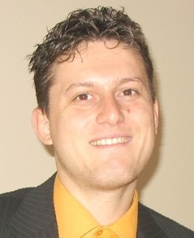
Trainers Team
Svetlin Nakov, PhD
Training & Inspiration Manager @ Software University
20+ years software development experience
10+ years experience as a trainer
Author of 7 programming books
Speaker at hundreds of events
Web site & blog: www.nakov.com

Slide 11
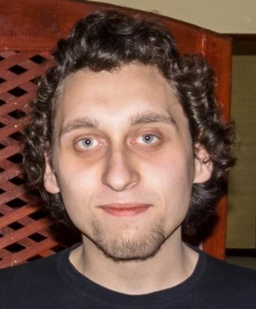
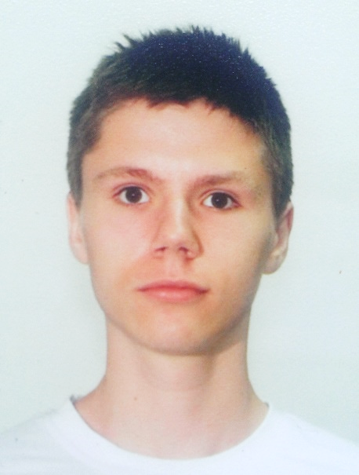
Trainers Team (2)
Yordan Darakchiev
Trainer @ Software University
Top performing graduate from the Software Academy (2013)
Top performing student at the Software University (2014)
Atanas Rusenov
Trainer @ Software University
Top performing student at the Software University (2014)

Slide 12
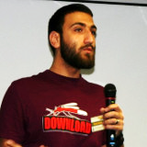

Trainers Team (2)
Mario Peshev
Part-time Trainer @ Software University
Lead Wordpress architect @ DevriX
Wordpress consultant and contributor
Certified Java programmer
Solid experience in PHP, Python and other scripting languages

Slide 13
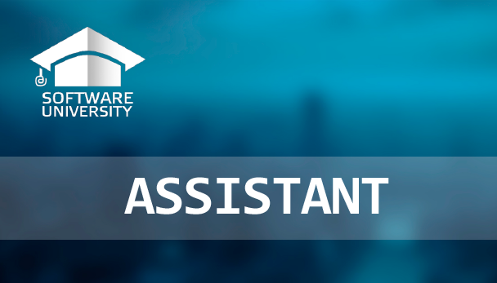
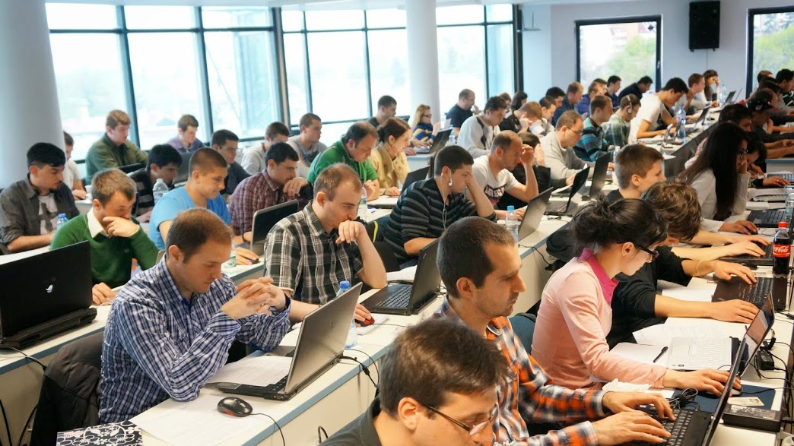
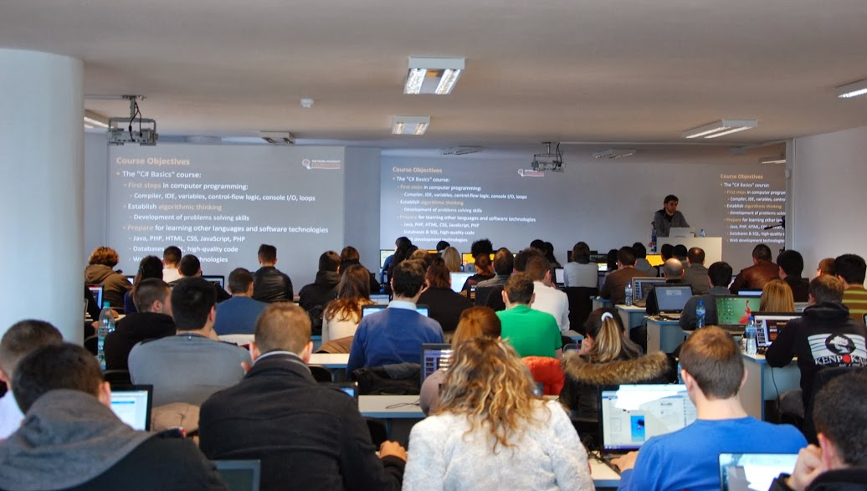
Volunteer Teaching Assistants
5+ volunteer teaching assistants
Scholarship students from SoftUni
Top students from SoftUni

Slide 14

OOP Course: More Details
Duration, Languages, Technologies

Slide 15


Training Duration – OOP
Lectures: ~ 30 hours (onsite + YouTube videos)
Practical exercises (in class): ~ 25-30 hours
Homework: ~ 30-50 hours
Labs: ~ 10 hours
Team project: ~20-30 hours
Exam preparation: ~ 20 hours
Exam: 6 hours
Schedule: 20 Jan – 27 Feb 2015
Exam date: 1 March 2015

Slide 16
Why OOP?
Object-oriented programming is an important paradigm
Anyone involved in software development should be familiar with OOP and OO modeling
All modern languages are either object-oriented or support classes and objects
Modern frameworks, libraries and APIs are object-oriented
E.g. .NET Framework Class Library (C#), Java API classes (Java), Laravel (PHP), Django (Python), Rails (Ruby), STL (C++), …
OOP is a basic requirement for starting a developer job

Slide 17



Why English?
Why the slides are in English?
English is the native language of software engineers
Specific terminology should be in English
Translations are inaccurate and funny
Just learn English!
No excuses

Slide 18
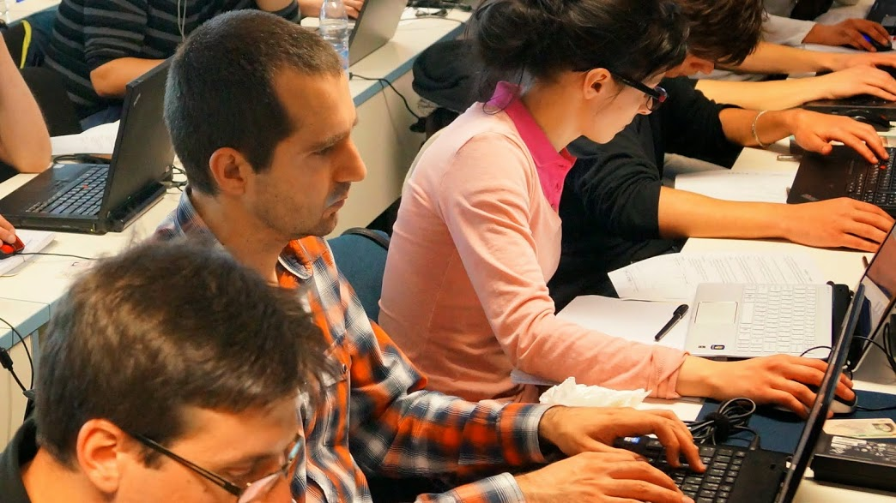


OOP Course
Evaluation Criteria

Slide 19


Scoring System for the OOP Course
Exam – 75% (80% for online students)
Up to 10% bonus from labs (onsite students)
Homework + evaluation – 5% + 5%
Team work project: 10%
Presence in class: 5% (onsite students only)
Bonuses: up to 10%
Forum activity bonuses
Others

Slide 20
The OOP Exam
1 practical problem for 6 hours:
You are given a project skeleton (empty classes and interfaces)
You should implement the missing functionality properly
Your project should be written in C# and should correctly follow all OOP principles
Automated judge system with real-time feedback gives only 50% of the total exam score
The other 50% come from code review by the SoftUni team

Slide 21
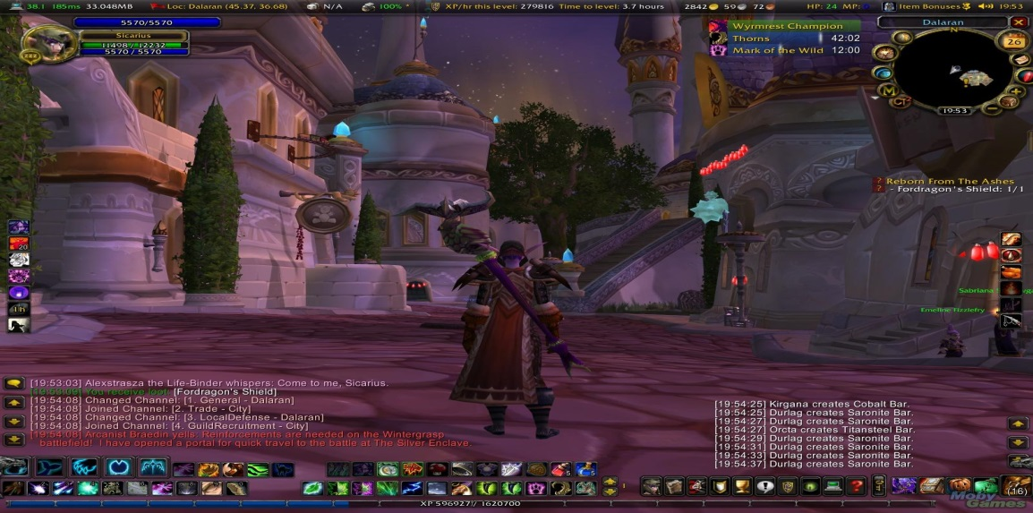
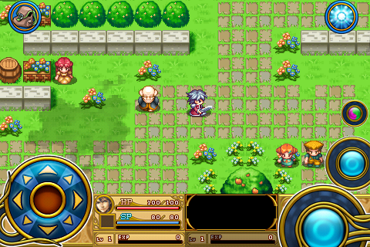
Teamwork Project
Create a 2D RPG game of your own choice
Should be OOP-structured and follow the good practices of OOP
Can be written in C# or Java (up to the team to choose)
Can be console-based or with a GUI

Slide 22

Homework Assignments
Doing your homework is very important!
Programming can only be learned through a lot of practice!
You should write code every day!
Each lecture is followed by a few exercises
Try to solve them in class
The rest are your homework
Homework assignments are due in 1 week after each lecture
Submission will be accepted through our web site: softuni.bg

Slide 23

Homework Peer Reviews
Give feedback to a few random homework submissions
Students submit homework anonymously
Please exclude your name from the submissions!
For each homework submitted
Students evaluate 3 random homeworks
From the same topic, after the deadline
Give written feedback, at least 200 characters
Low-quality feedback → report for punishment
Everyone will get feedback for their homework

Slide 24









Resources
What Do We Need Additionally?

Slide 25

Course Web Site & Forums
The OOP Course official website:
Register for the "Software University Forum":
Discuss the course exercises with your colleagues
Find solutions for all course exercises
Share source code / discuss ideas / help each other
https://softuni.bg/trainings/coursesinstances/details/8
https://softuni.bg/forum

Slide 26



The OOP Slides and Videos
All lecture slides, videos, homework assignments, projects and other resources are open content, available for free
Visit the course web site to access the course resources

Slide 27
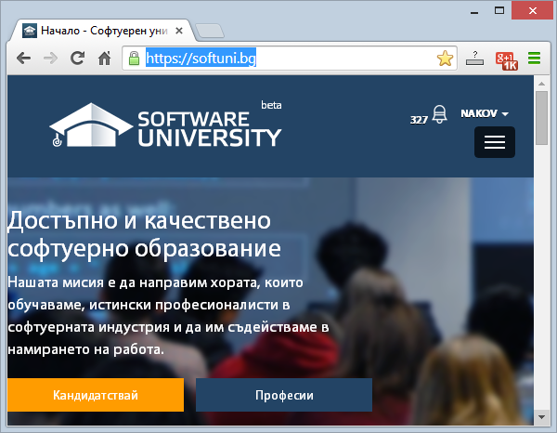
Software University Learning System (SULS)
Software University Learning System (SULS)
www.softuni.bg
Important resource for students
Homework submissions
Homework check-up
Exams and results
Reports about your progress
…

Slide 28

Summary
The "OOP" course provides
Fundamental understanding of OOP programming
Training program
OOP basic principles, using Classes and application in in different OOP Languages
Practical exams
Automated judge system + code review
Learning resources
Lectures, videos, software, books, forum
OOP Course

Slide 29
OOP – Course Introduction
https://softuni.bg/courses/oop/

Slide 30
SoftUni Diamond Partners

Slide 31
License
This course (slides, examples, demos, videos, homework, etc.) is licensed under the "Creative Commons Attribution-NonCommercial-ShareAlike 4.0 International" license
Attribution: this work may contain portions from
"Fundamentals of Computer Programming with C#" book by Svetlin Nakov & Co. under CC-BY-SA license
"OOP" course by Telerik Academy under CC-BY-NC-SA license

Slide 32





Free Trainings @ Software University
Software University Foundation – softuni.org
Software University – High-Quality Education, Profession and Job for Software Developers
softuni.bg
Software University @ Facebook
facebook.com/SoftwareUniversity
Software University @ YouTube
youtube.com/SoftwareUniversity
Software University Forums – forum.softuni.bg

